Slide 1

Energy: Fundamental Concepts

Slide 2
We can think thoughts wildly, but if we do not have the wherewithal to convert them into action, they will remain thoughts.
History acts in unpredictable ways. Events in history, however, necessarily take on a structure or organization that must accord with their energetic components.
Richard Adams (1982)
Notes:
Humans depend on

Slide 3
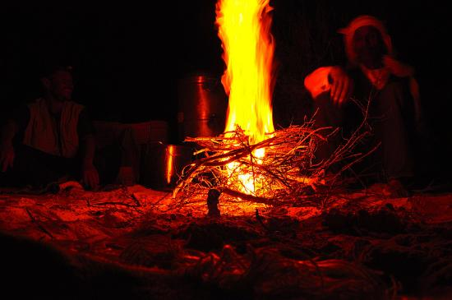

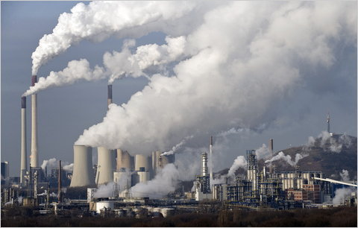

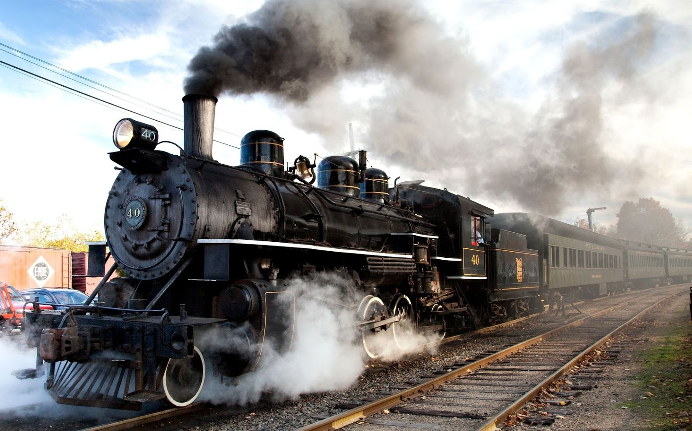
Energy and Civilization
Food
Wood
Coal
Oil / gas
Can we do better?
Energy is a measurement of work done.
Notes:
Food feeds muscles, and that’s all we’ve got at the beginning.
We chop ‘em, we burn ‘em for fire.
It’s dirty, but it gets the job done and the Brits around the world.
Cleaner, provided you fight the wars needed to get them.

Slide 4

Stores and Flow
Fundamental quantitative concepts

Slide 5
Stores and Flow
Oil
Coal
Wood
Useful work
Energy store / energy source
losses
Energy efficiency
Energy flow

Slide 6
Measurements for Store and Flow
Amount
Rate (power)
Joule (J)
Joule / sec (J s⁻¹)
Watts (W)
Other energy amount units: calorie (cal), erg, electron volts (eV), Hartree
Other power units: horsepower (hp)

Slide 7
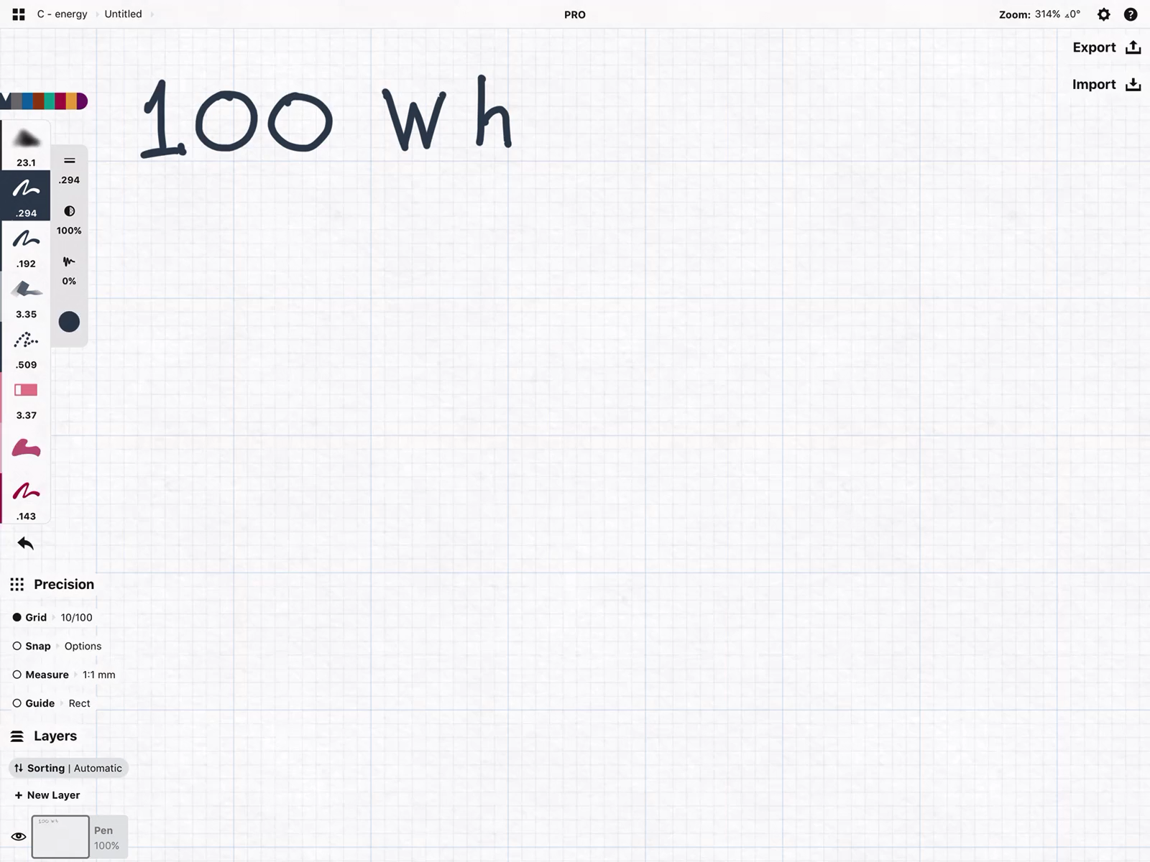
Must-have Habits for calculations
Write out units explicitly
Re-write W as J / s
Write out conversion factors with units
Explicitly cancel out units
Calculate the amount of energy, in kJ, contained in a 100 Wh (watt-hour) battery.

Slide 8
Rate of Energy Release
Needs to be reasonable
Too slow
Just right
Too fast

Slide 9

Control: Energy Efficiency
The input-output ratio

Slide 10

Forms of energy

Slide 11
Energy efficiency
Energy efficiency = output / input x 100%

Slide 12
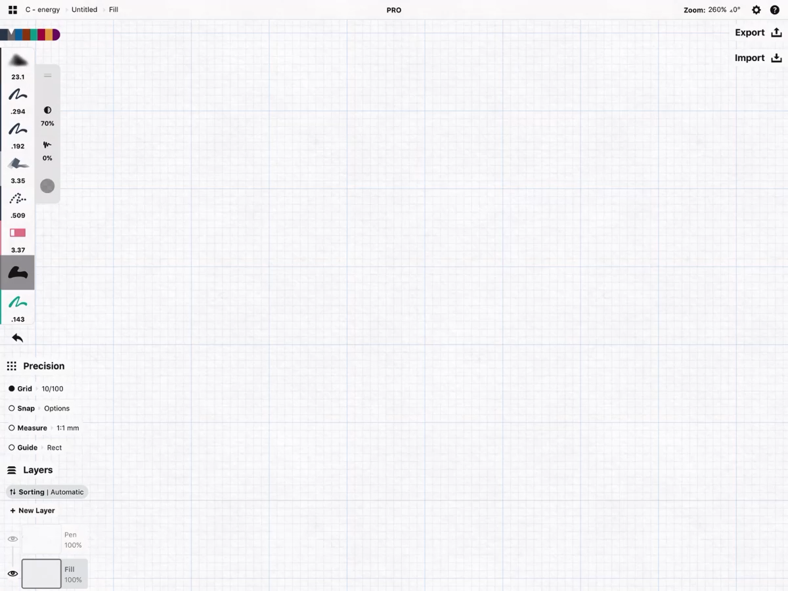
Example
For coal, the following efficiencies were measured for home heating:
Extraction of raw material: 0.67
Processing: 0.92
Transporting the fuel: 0.98
Chem-> electricity in power plant: 0.35
Transmission to house + heating: 0.90
Calculate the energy efficiency.

Slide 13
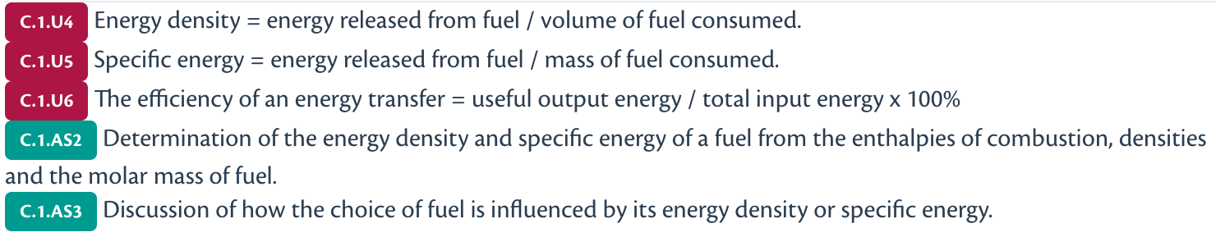
Energy concentration
Energy density & specific energy

Slide 14
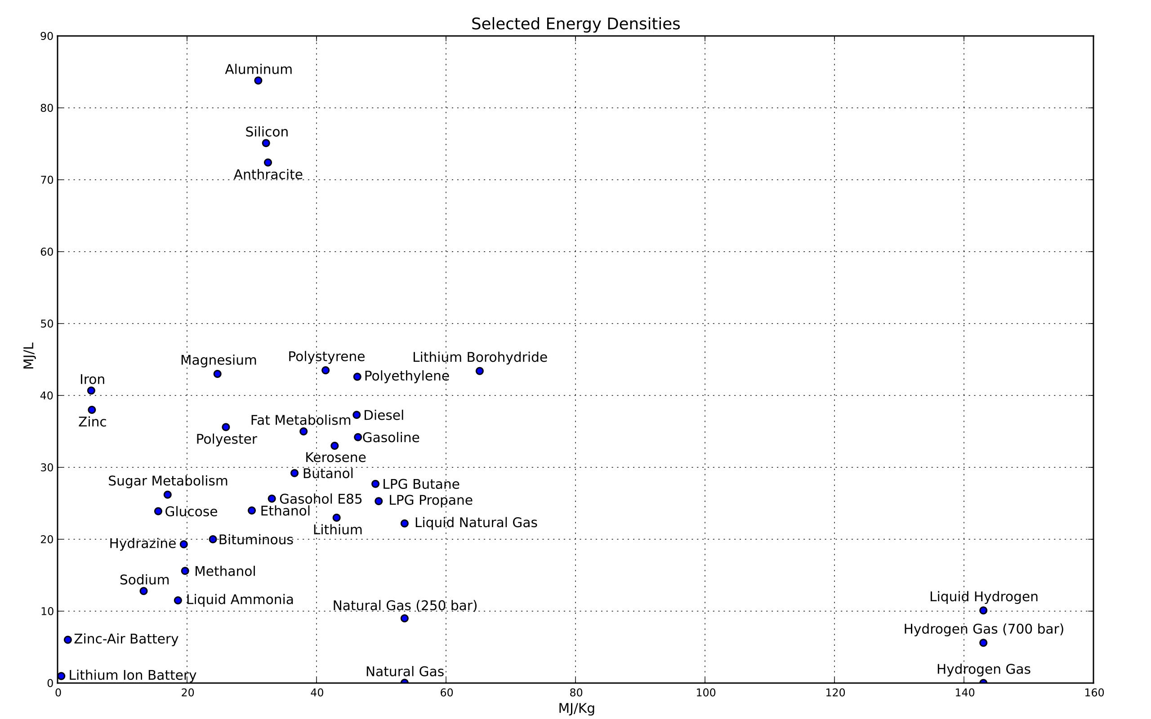
Two definition of energy concentration
By volume
Energy density: E/v
By mass
Specific energy: E/m

Slide 15

Sustainability
Metric for a renewable future

Slide 16
Renewable energy
A source is renewable if
Rate of replenishing > rate of depletion
replenishing
depletion
replenishing
depletion
Non renewable | Renewable
Coal | Solar
Oil | Wind
Gas | Geothermal
 | Wood

